Slide 1

Introduction to Bots, Luis and Flow

Slide 2
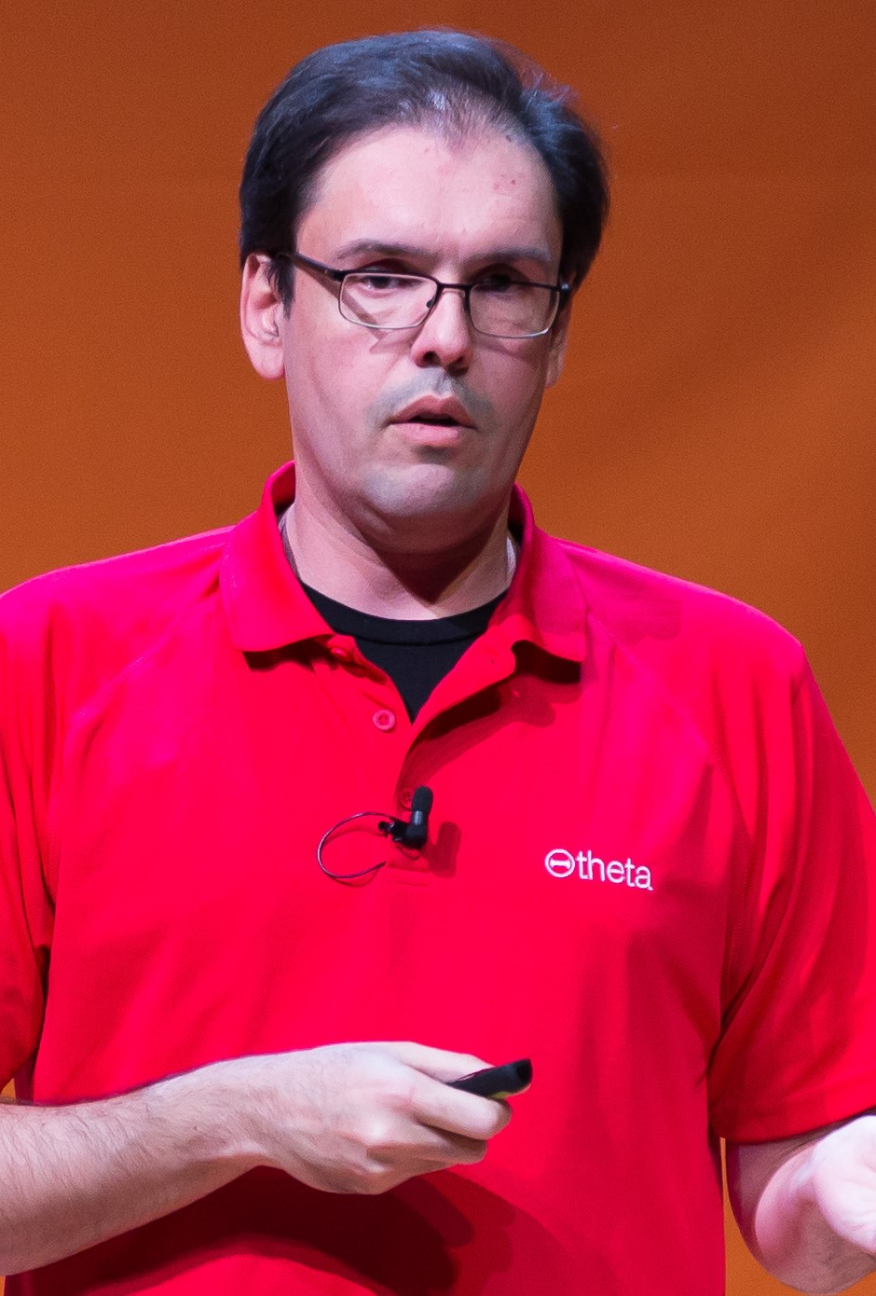




About me
Principal Integration Architect
Microsoft Azure MVP
MS P-TSP
MCA Cloud Platform
ACSUG co-organizer
wsilveiranz
wagner.silveira@theta.co.nz
http://notetoself.tech

Slide 3


Acknowledgements
Kent Weare
‎Principal Program Manager – Microsoft Flow
Give your Bots connectivity, with Azure Logic Apps and Microsoft Flow
Notes:
Most of these slides are taken from Kent’s presentation at Integrate 2017 USA

Slide 4

Acknowledgements
Eldert Grootenboer
‎Integration Architect – Motion 10
Microsoft Azure MVP
Using Azure to Build Intelligent Bots
Notes:
Some slides are from Eldert

Slide 5

Acknowledgements
Dan Toomey
‎Principal Consultant - Mexia
Microsoft Azure MVP
Luis and Bots
ALSO:
https://github.com/AzureCAT-GSI/DevCamp
Notes:
Some slides are from Eldert

Slide 6

Bots
Conversation is the new UI,
Bots are the new Apps

Slide 7
Rise of the Cognitive Assistant
Assistants are being embedded everywhere; are increasing ability to solve problems.
As computing advances, so will Virtual Assistant ability to help in task completion.
Virtual Assistants ability to be “smart”, and to understand intent, tone, and context.
Market demand for meaningful, stateful and goal oriented conversations.

Slide 8
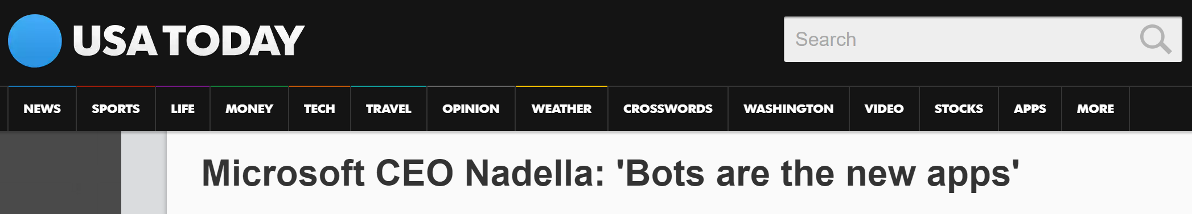
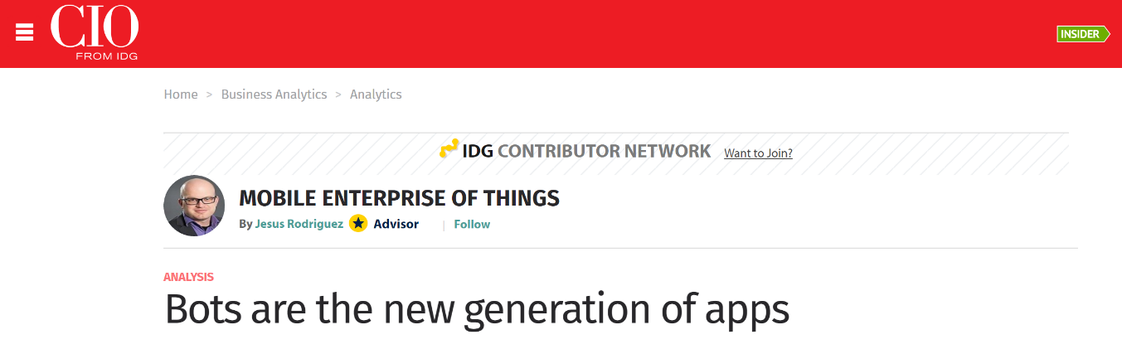
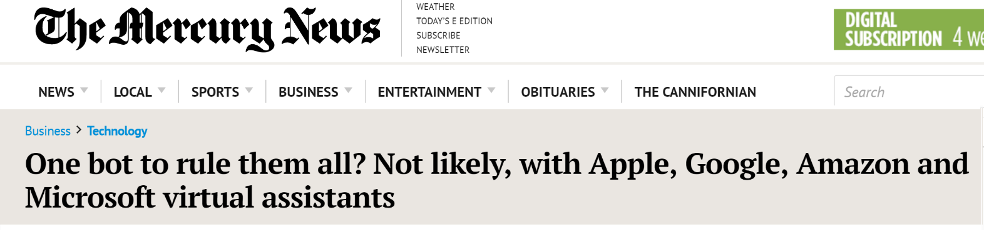
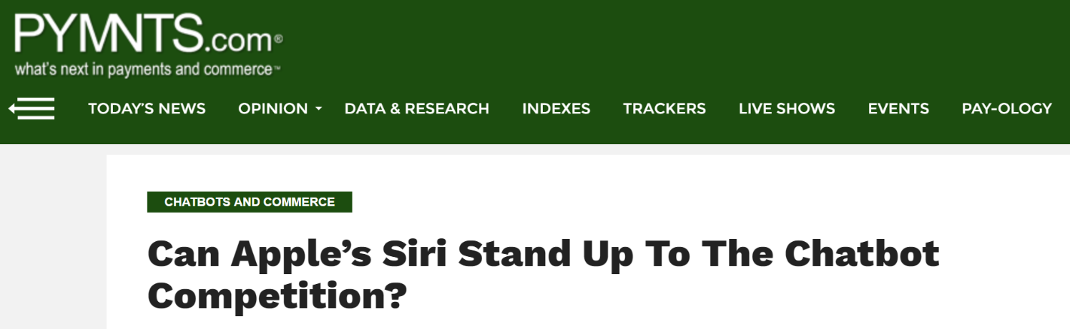
Bots are the new Apps
BOTS – The Hype

Slide 9
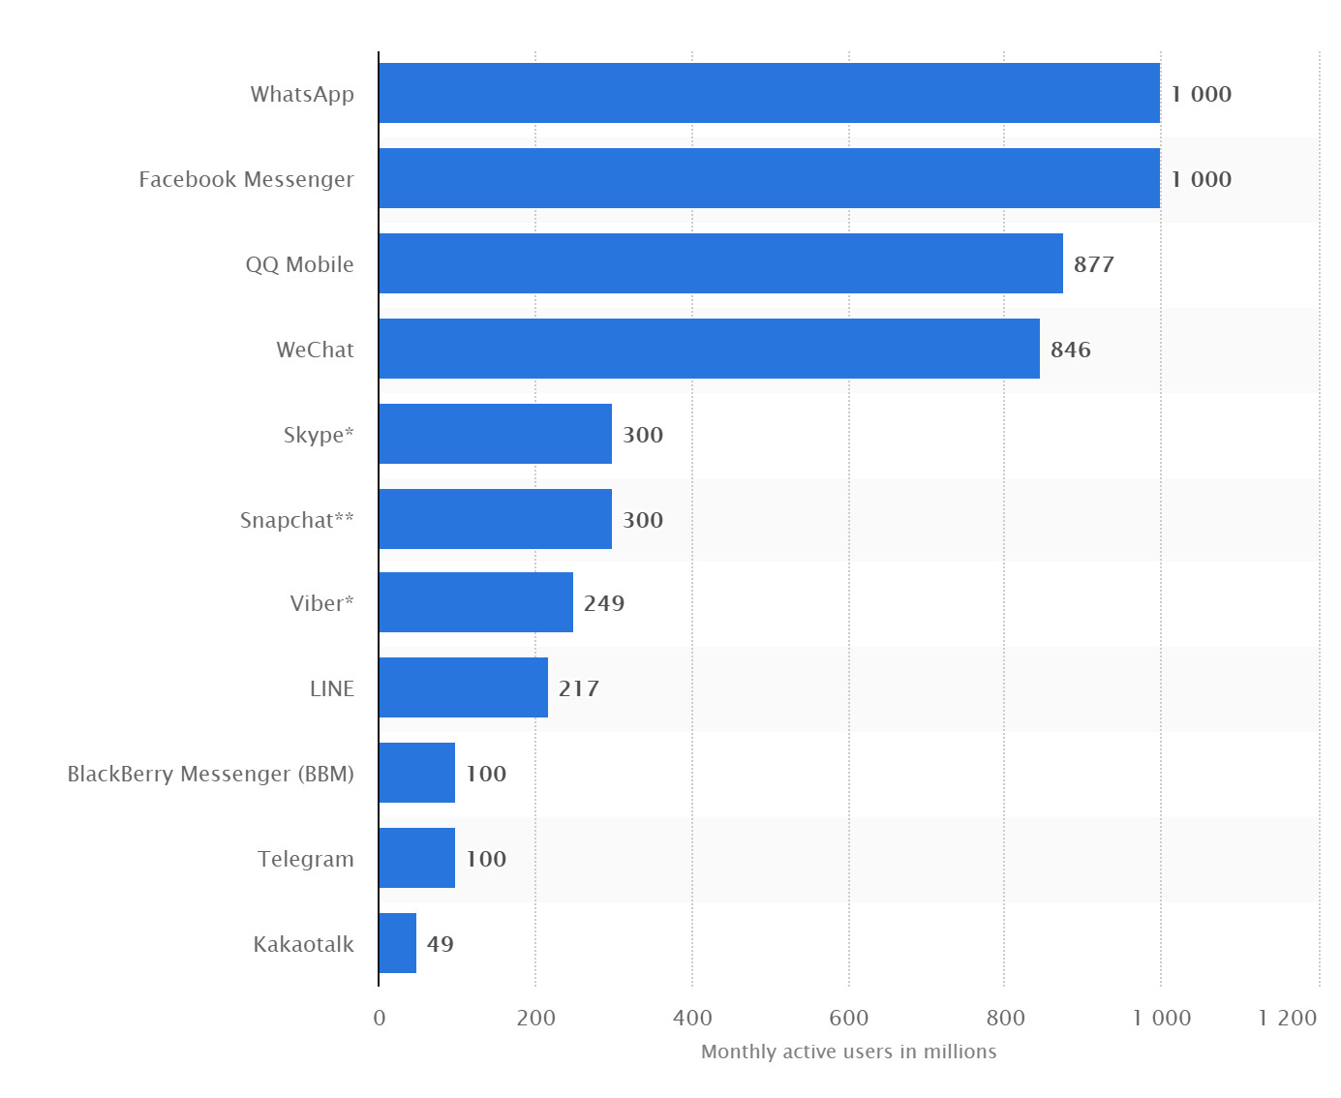
Bots are gaining in Popularity for Good Reason
Monthly Active Users
Most popular mobile messaging apps worldwide - January 2017
- Statista 2017

Slide 10
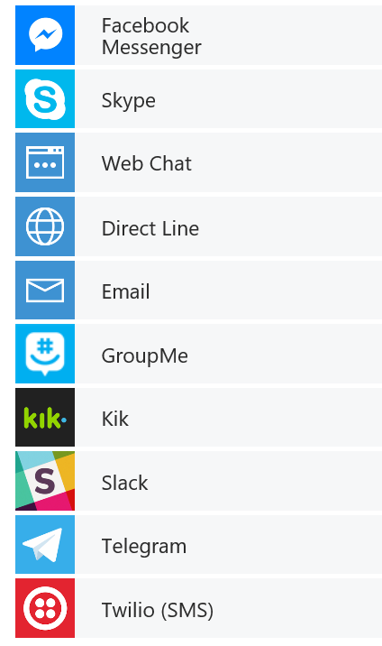


What is a Bot ?
channels
Humans
Your Bot – A web app
Any APIs
MS Bot Connector -
Routes Messages, Manages State, Storage etc.
Cognitive APIs

Slide 11






What is the Bot Framework?
What?
Tools for building REST Web Sites
Services to enrich
Mechanisms for receive events
Data to debug and analyze
Customer’s
Business Logic & Data
Bot Connector
Why?
Implements standard protocols
Modeling conversations is hard. Tools help!
UI across multiple canvases is hard. Cards rock!
Language Understanding is hard
Common and well understood patterns
C#
BOT BUILDER
Bot Controls
Skype
Bing
Web Chat
Goals
Start Simple. Add Complexity. No dead-ends.
Bot adapts to the user, based on context
Composable and intelligent controls to manage complexity
LUIS
Form Filling
QnA
Skype for Business
Cortana
Direct Line
Query over database via Azure Search
3rd Party
Notes:
BOT builder:
Full SDK for .NET, Node.js
Emulator
Sample Bots
Bot Framework portal:
register,connect and manage bot in an easy and convenient way
Includes diagnostic tools and web chat control for embedding on a web page

Slide 12

Vision
From faces to feelings, allow your apps to understand images and video
Microsoft Cognitive Services
Give your apps a human side
Speech
Hear and speak to your users by filtering noise, identifying speakers, and understanding intent
Language
Process text and learn how to recognize what users want
Knowledge
Tap into rich knowledge amassed from the web, academia, or your own data
Search
Access billions of web pages, images, videos, and news with the power of Bing APIs

Slide 13
Language Understanding
Language understanding in human-computer interaction is:
Technically challenging
Costly
to implement
Often
domain specific
It’s exceedingly difficult to enable a computer to understand what a person wants and to find the pieces of information that are relevant to their intent.
Building and maintaining machine learning systems requires a large investment of time, money and engineering resources
In the past, building your own machine learned models often required assistance of a team of data scientists that would customize the models to the specific domain.

Slide 14

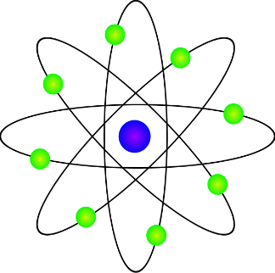


Language Understanding Intelligence Service (LUIS)
Train by providing
examples
Create your own LU model
Deploy to an HTTP endpoint and activate on any device
Maintain model with ease

Slide 15
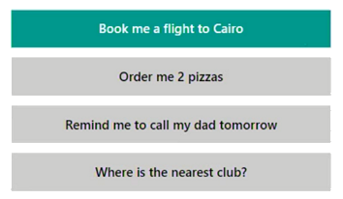

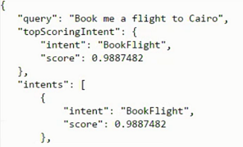
Behind the scenes
Notes:
A user may be typing simple requests based on natural language. For example, a user may type "I want a pepperoni pizza" or "Are there any vegetarian restaurants within 3 miles from my house open now?". Natural language understanding APIs such as LUIS.ai are a great fit for scenarios like this. Using the APIs, your bot can extract the key components of the user's text to identify the user's intent.

Slide 16
Acting on Intents

Slide 17

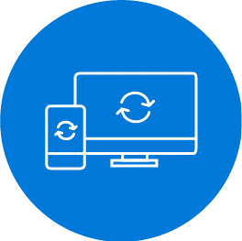


Microsoft Flow helps non-developers work smarter by automating workflows across services
Get notifications
Copy files
Collect data
Automate approvals
Notes:
Microsoft Flow is a SaaS service that helps you work smarter by automating workflow across your growing number apps and services that business users rely on.
The possible workflows span across a wide variety of possibilities, for example :
Get a notifications when a certain file is updated. A user was tired of manually notifying his team of new sales lead in Dynamics so he signed up his team members to receive notifications every time he added a new lead.
Synchronize files by connecting your folders to keep data current. I have a folder on my OneDrive for Business that automatically syncs with a specific document library on the team SharePoint.
Automatically collect and organize your business data. Collect emails from specific senders/customers and track them in an Excel file that’s shared with your team.
Streamline approvals and get instant alerts. Set up an automated system to get approvals for expenses, upcoming trips.
Microsoft Flow makes it possible to automate all of these scenarios and more.

Slide 18
Who is the audience for Flow?
Flow focus: Business Users & Specialists
(Office, Dynamics)
Volume
Logic Apps focus: IT Pro / Developers
(Visual Studio, Azure)
Sophistication

Slide 19
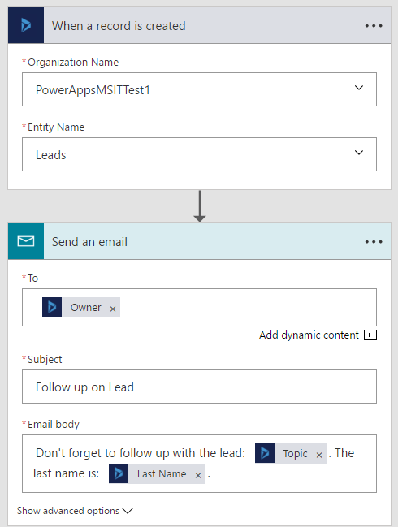
What makes up a Flow?
Example: Notification Flow
Trigger – the event that kicks off the flow:
manually
on a schedule
on an event in the cloud
Actions – what the flow does
Can use data from the trigger
Notes:
The exact same designer that is used in Logic Apps is used here. Under the hood, Flow is built on top of Logic Apps and uses the public APIs and standard runtime.
In addition to utilizing Templates, end-users can easily build their own Flows or customize any of the available templates through an easy to use visual designer.

Slide 20
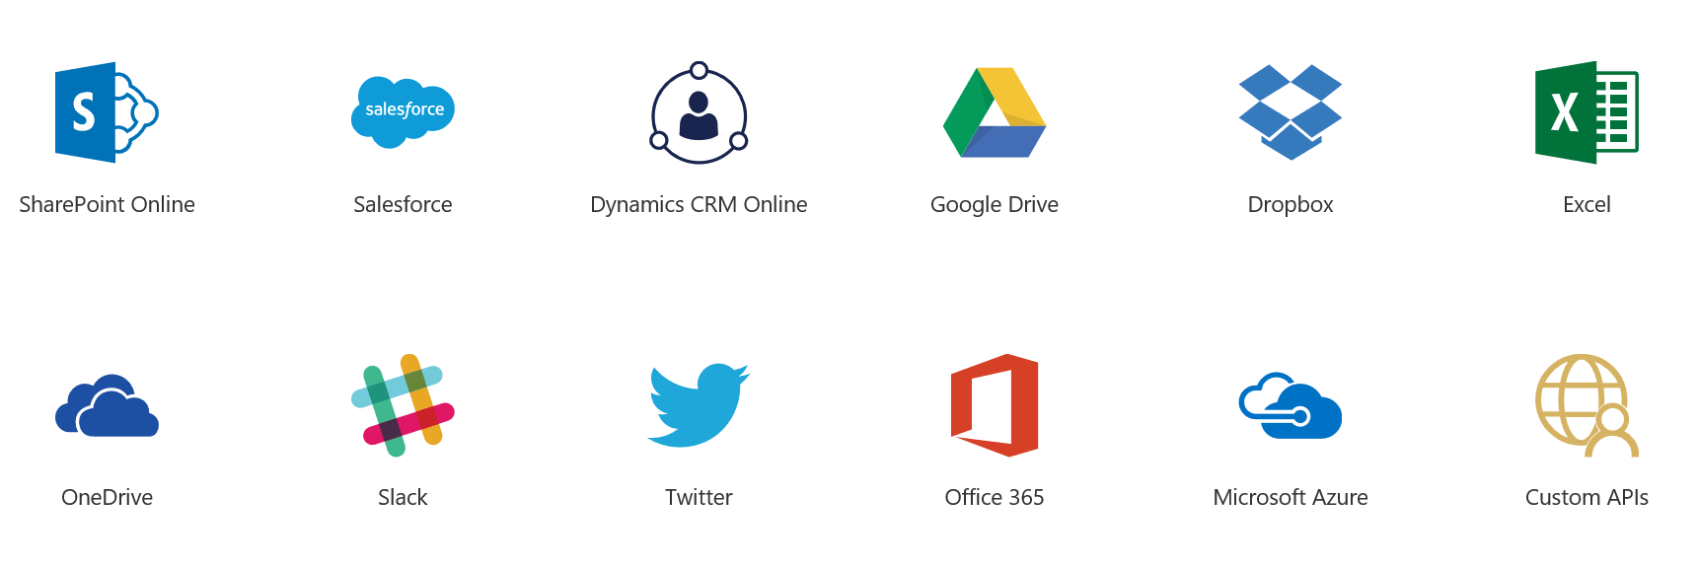

Connect to cloud and on premises data
Over 170 out of the box connectors with new connectors every week
Use Custom Connectors to connect to any custom REST endpoint
Connect to on-premises data using gateways
Notes:
Just like in Logic Apps, you can connect to cloud services and on premise data.
Connectors include Microsoft services (O365 and D365) and external services too – MailChimp, Salesforce, Slack etc.
These connectors are common across Flow and PowerApps, Logic Apps, so if you connect to a service in one product, you can use them from the other products as well.

Slide 21
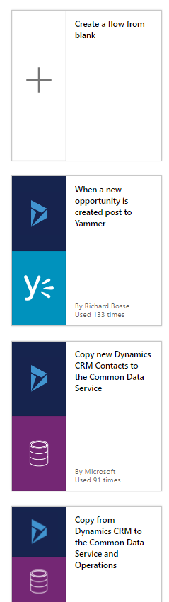
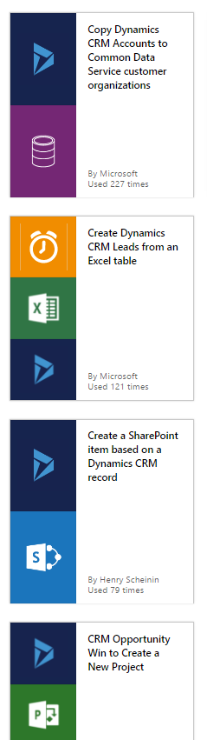
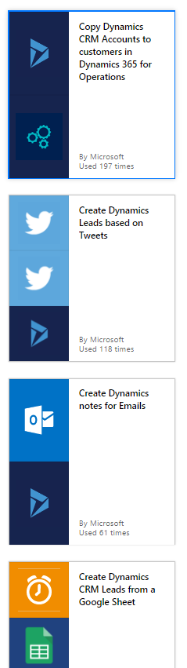
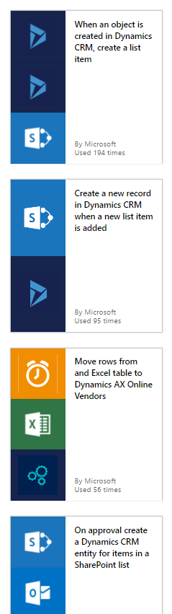
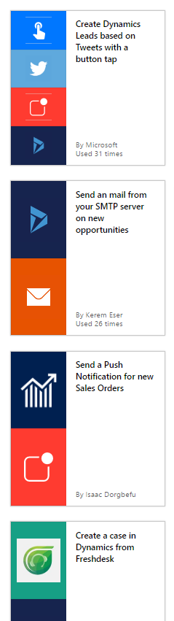
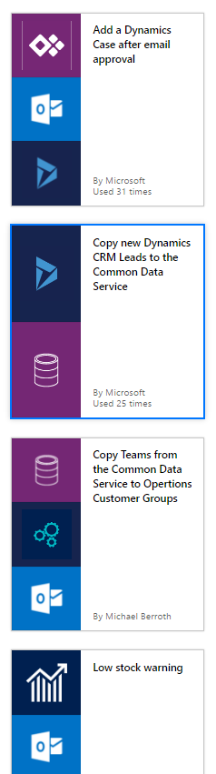
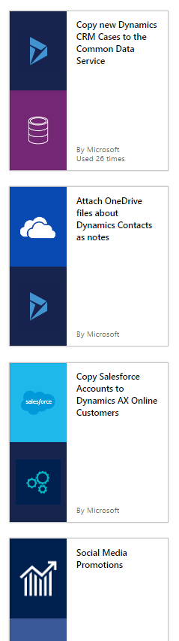
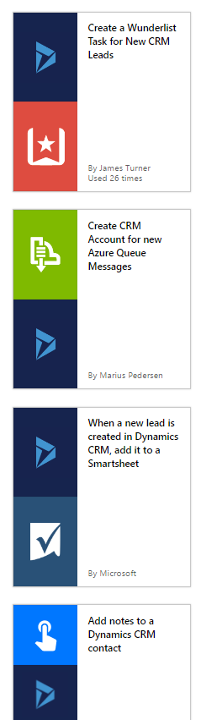
Templates help users get started
Notes:
User aver 100+ templates (and growing) for common scenarios as a starting point to create your new workflow!
Various use cases – many of which have been submitted by users like yourselves.

Slide 22
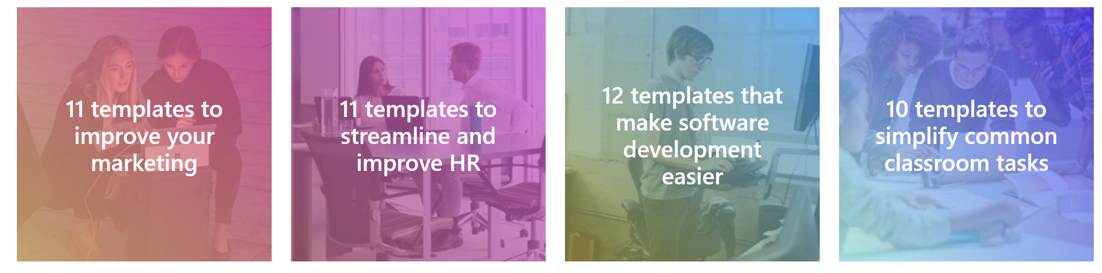
Verticals for various professions
Notes:
We have six published verticals at this time, and will be adding more in future updates. You will see verticals for personal productivity, field workers and sales teams coming up in the next few weeks

Slide 23
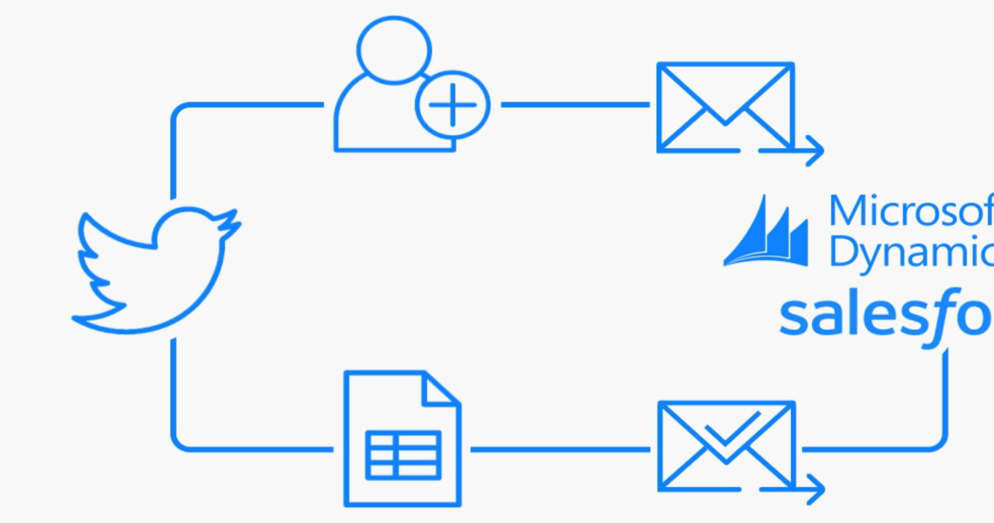



Automate advanced scenarios with multiple steps, branching conditions, scheduling, looping and more
Notes:
Create more advanced integration scenarios with multiple steps, adding conditions between step and the every expanding list of more advanced enterprise connectors.
All without writing a single line of code.

Slide 24
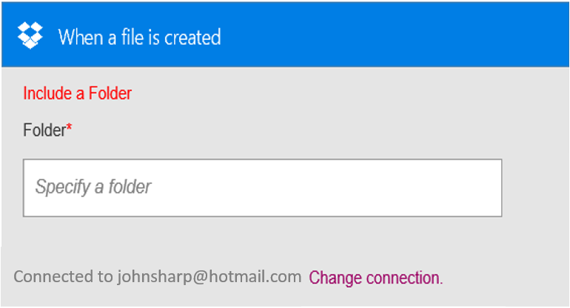
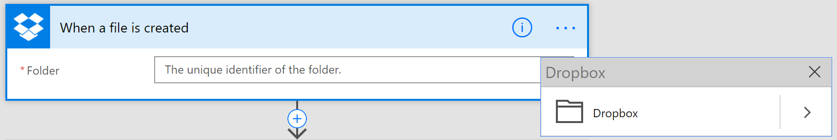
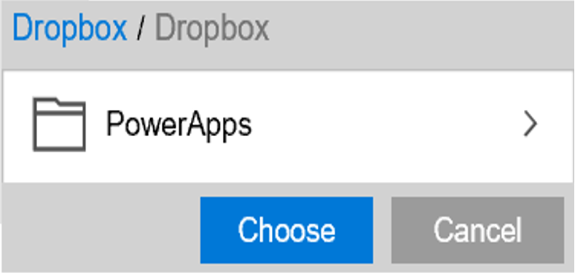
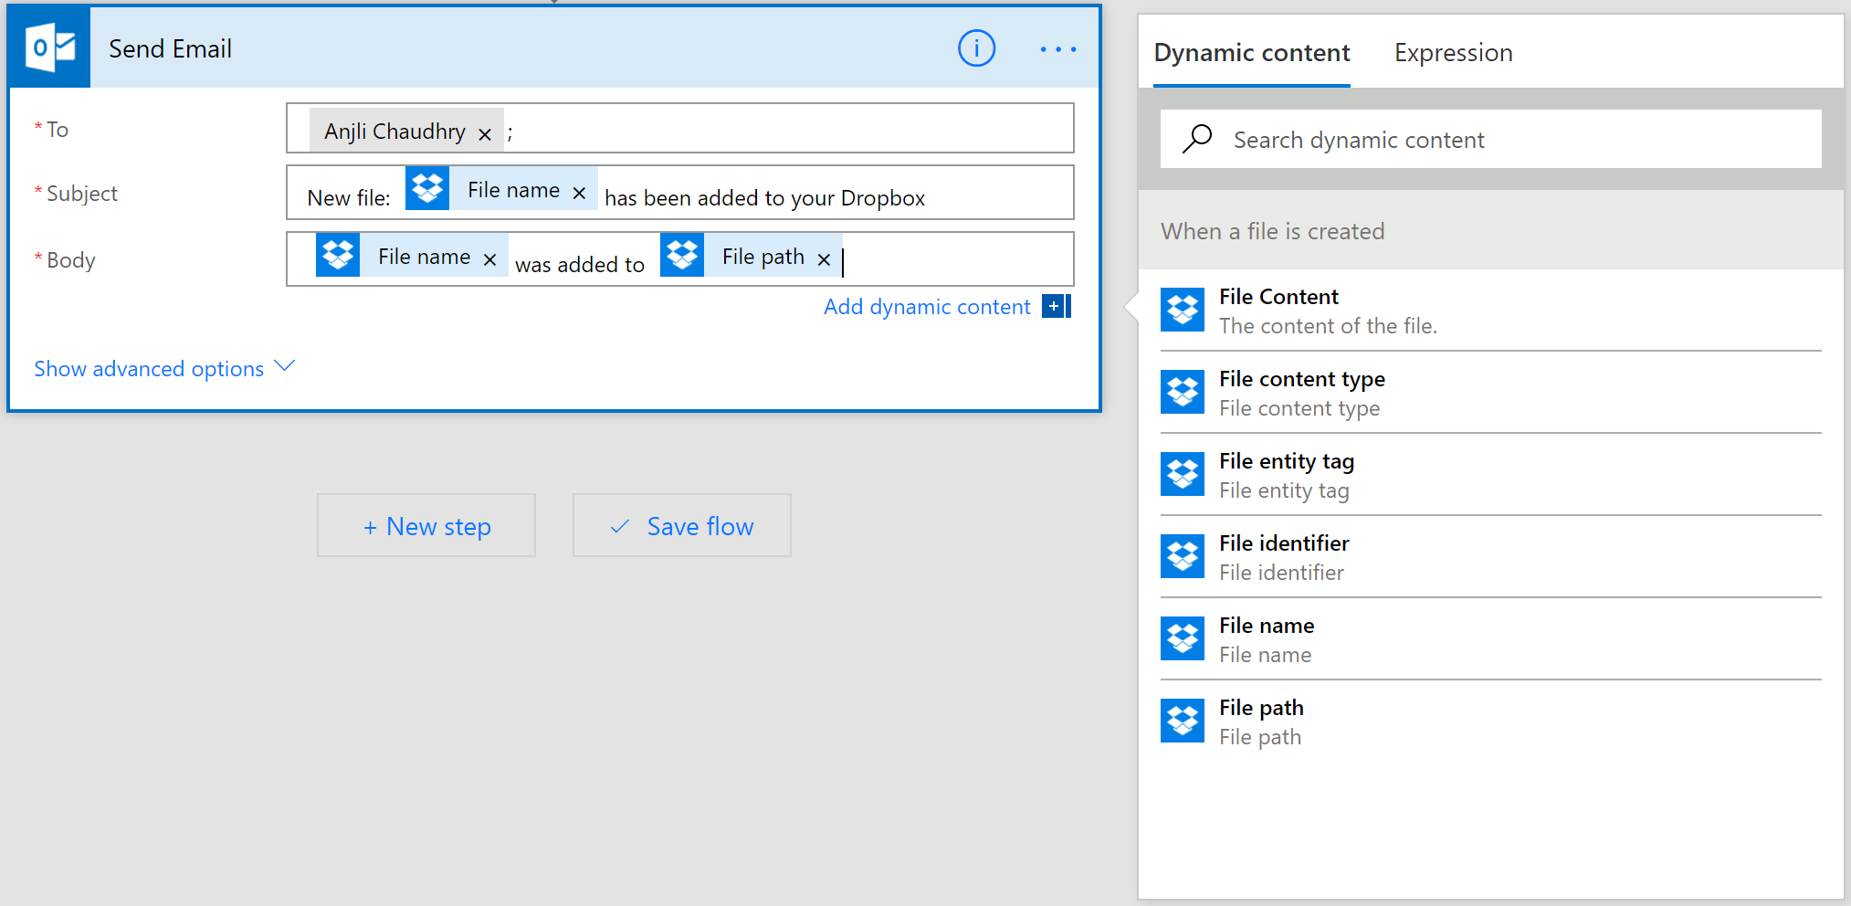
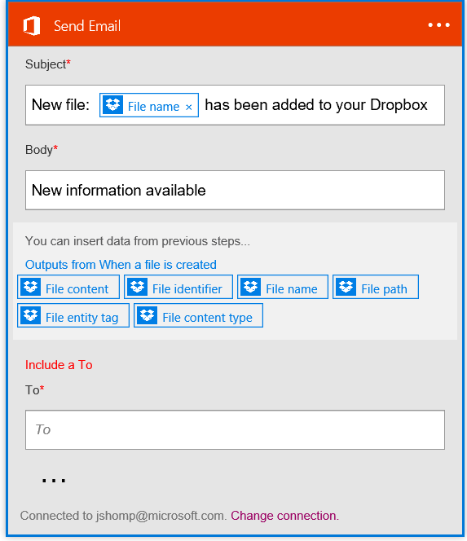
Build flows from scratch
Sending an Exchange email when a new file is added in Dropbox
Flow
Authenticate to your Dropbox account.
Select folder to monitor
PowerApps
Choose to include properties from previous step (Dropbox file) to improve relevance
Authenticate to your O365 account. Build email Subject and Body
Specify Send To email address and additional properties (optional): From, CC, BCC and Importance
Connected to johnsharp@contoso.com
Notes:
In addition to utilizing Templates, end-users can easily build their own Flows or customize any of the available templates through an easy to use visual designer.
In this example I want to receive and email in my Exchange email box every time a new file gets added to my Dropbox account.
Simply select the “Dropbox - When a file is created” trigger and provide my account details to authenticate. Once authenticated and can simplify select the folder I want to monitor on my account.
As a next step, I select the Office 365 Outlook – Send email function. This will prompted my to logon to my O365 email account. I have different properties available which I use directly in the subject, body an ‘To’ address of the message that will be send based on the Drop box trigger.
I simply save the Flow I just created, and it is now ready for execution.

Slide 25
Lab #2
Creating a Smart Expense Claim Bot Using Flow & Bizzy

Slide 26
Lab #2 Prerequisites
Azure Subscription
Office 365 with SharePoint Online (TRIAL: https://signup.microsoft.com/signup)
Azure Storage Explorer (http://storageexplorer.com)

Slide 27
Lab #2 Steps
Set up LUIS
Create Bizzy account
Create SharePoint list
Create Flow
Test the Solution
Notes:
In this fourth lab, we will be receiving the orders from the business customer’s topic in a new Logic App, and check the total amount of the invoice. In case the customer placed a large order (over $50000), we will create a task for one of our sales employees to contact the customer to verify the order. In case the order is correct, the invoice will be emailed to the customer. The Logic App will then call a function, in which we will check a storage table to determine how much discount the customer will be given (based on the total order amount), and finally will place a file on blob storage, which will be used by an employee to refund the customer.

Slide 28


Reference material
Microsoft Flow
https://flow.microsoft.com – Do you have Office 365?...You then have Flow.
Azure Logic Apps
https://azure.microsoft.com/en-us/services/logic-apps/
Microsoft Research Cognitive Services YouTube Channel
http://tinyurl.com/hob5zjp
Bizzy – The Enterprise Bot
https://getbizzy.io

